Slide 1


Team 15: Rogue Chess App
Bi-Weekly Update 1 Jose Herrera, Travis Head Sponsor: Pranav Dhulipala TA: Eric Robles
Notes:
Michelle

Slide 2
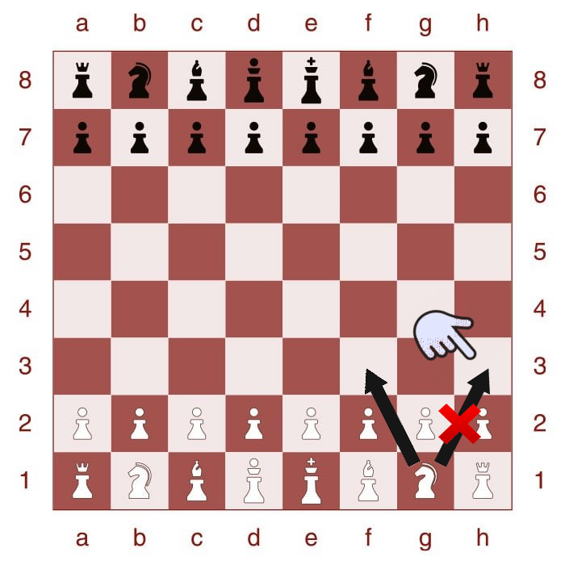
Project Summary
Problem: There are many variations of the game of chess; however, after a while it can be predictable or lack of excitement.
Proposed Solution: Develop an app of a new chess variation with a randomization factor for Android products.
Develop an AI for Single Player Mode
Create a randomization factor
Create a User Interface for the players interaction
Highlighted boxes to assist the player in making the next move legally
Create different difficulty levels
Upload the contents to the cloud

Slide 3
System Overview
Game Functionality (Jose)
Board
Move Chess Pieces
Legality of move
Artificial Intelligence (Travis)
User Interface (Jose)
Application
Neural Network
Main Menu
Settings
Android
Phone
Cloud

Slide 4
Game Functionality Subsystem
Game Functionality (Jose)
Title Menu
Setting Button
Home Button
Instructional Page
Chess Board
Chess Pieces (movement)
Highlights for the next move
Board
Move Chess Pieces
Legality of move
User Interface (Jose)
Application
Main Menu
Settings

Slide 5
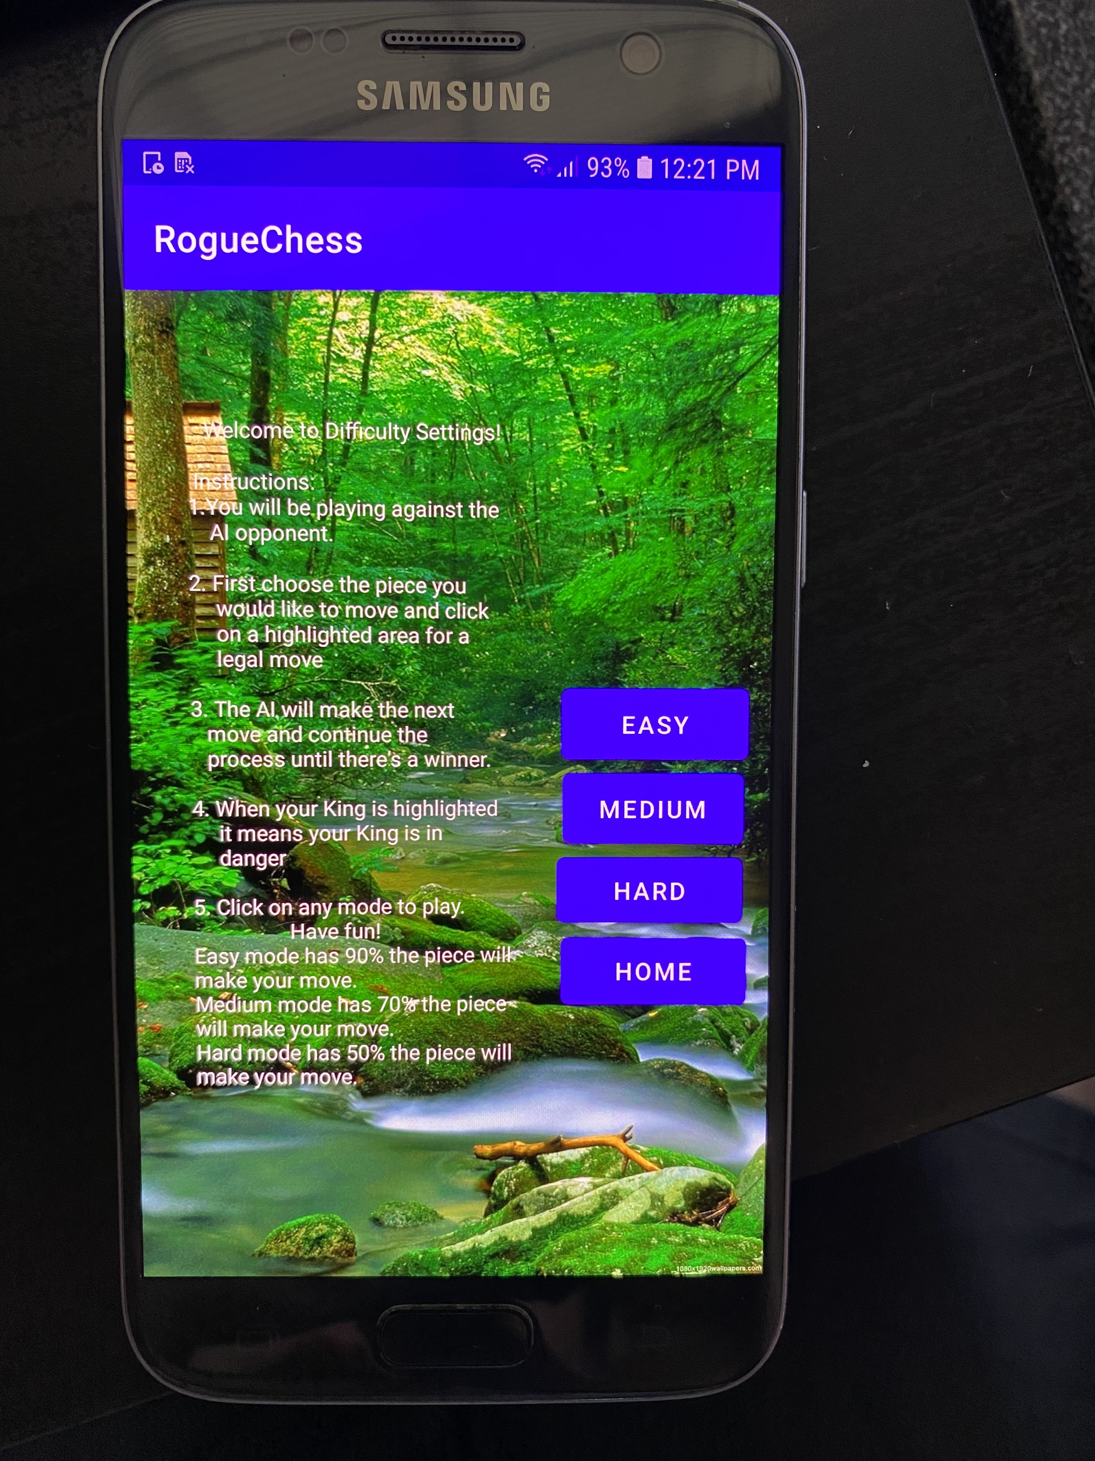
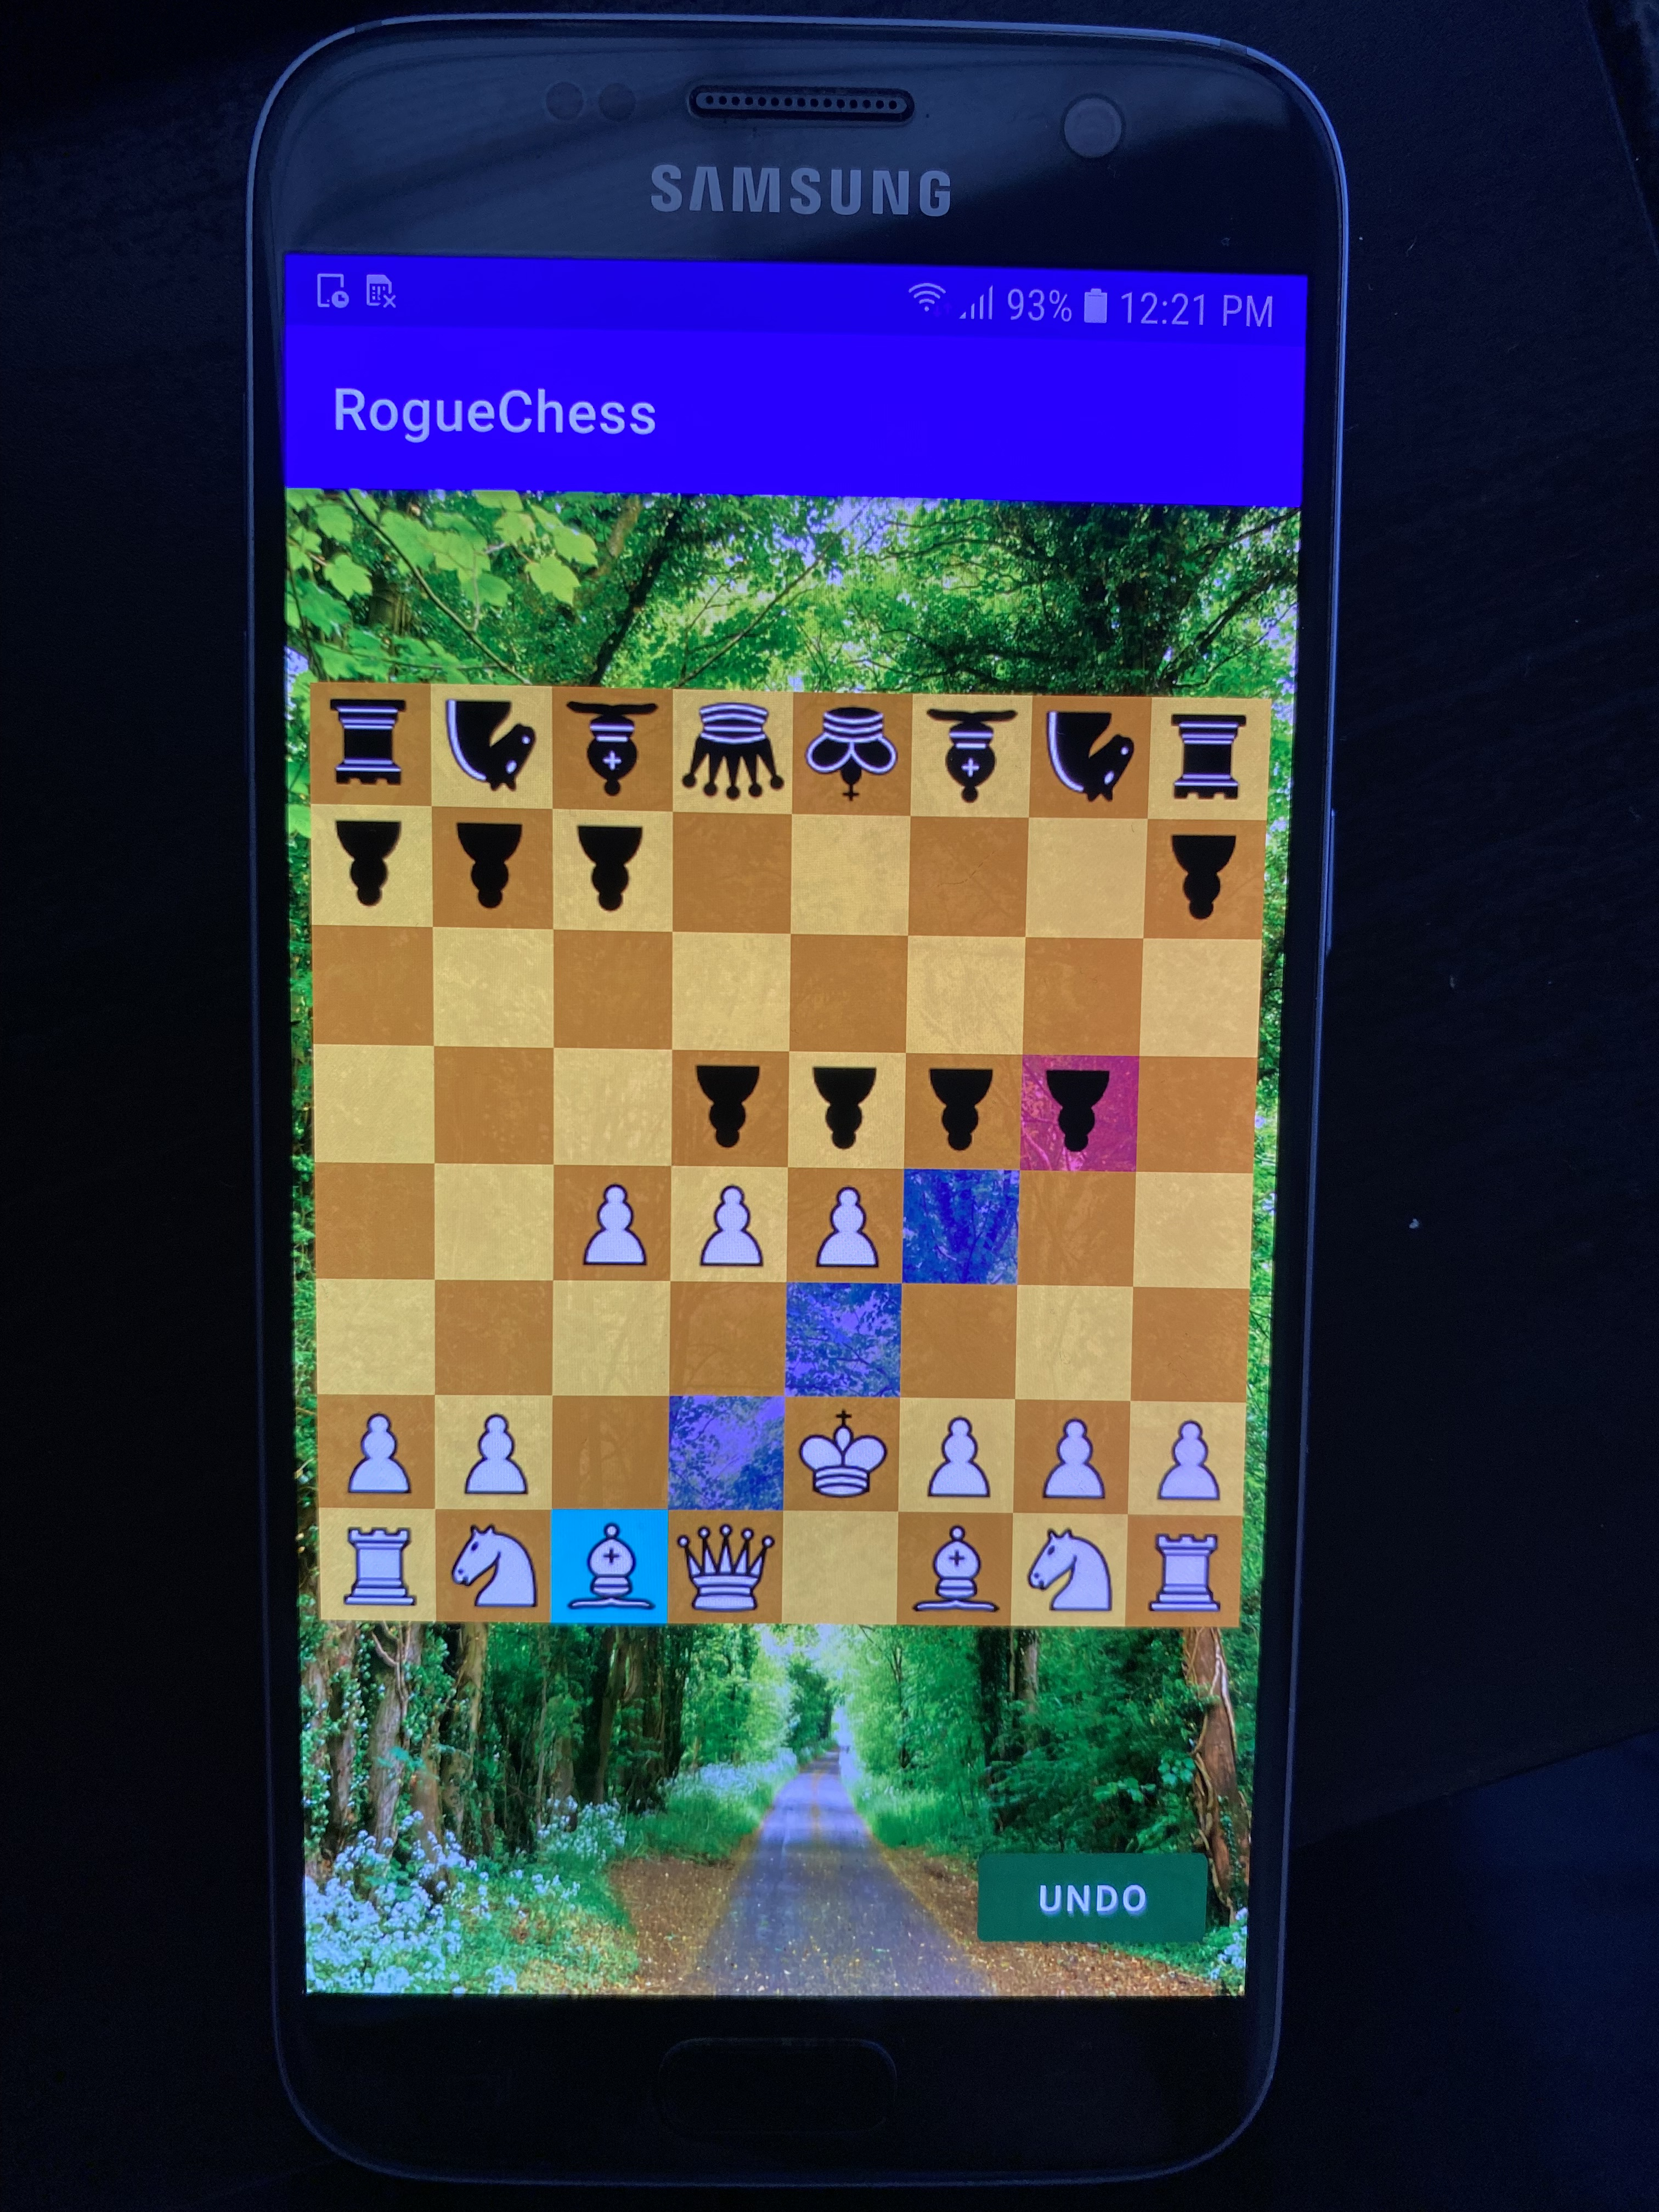
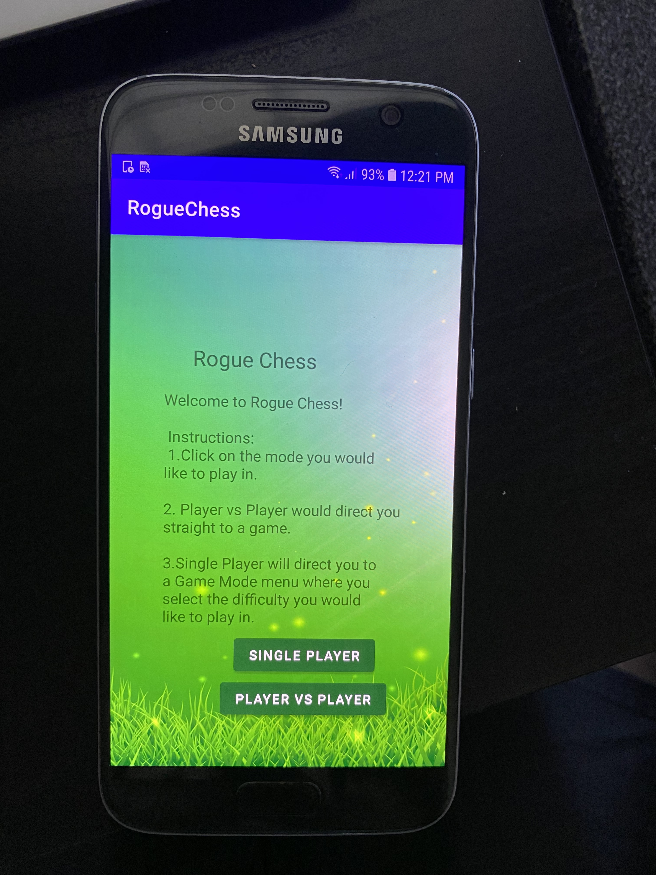
Game Functionality Subsystem

Slide 6
Game Functionality/User Interface
Jose Herrera
Accomplishments since 403 0 hrs of effort | Ongoing progress/problems and plans until the next presentation
The app is working perfectly (no crashes) The pieces move The moves are all legal (no random clicking is allowed) The Player Vs Player mode is playable Buttons function properly | Add Difficulty modes Add Castling Rule

Slide 7
Artificial Intelligence Subsystem
Application
Convolutional Neural Network
Uses Supervised Learning
Takes in Board State from User
Independently Plays Against User
Board State
Neural Network
Best move
Notes:
Eric

Slide 8
Artificial Intelligence Travis Head
Accomplishments since 403 0 hrs of effort | Ongoing progress/problems and plans until the next presentation
A.I. recognizes piece type Recognizes piece positions from board Recognizes Available Attacks Can make independent moves | Upload to Microsoft Azure A.I. is weak and needs improvement

Slide 9
Major Project Changes for 404
A.I. Training Dataset being replaced to use games played by Grandmasters
Notes:
Eric

Slide 10
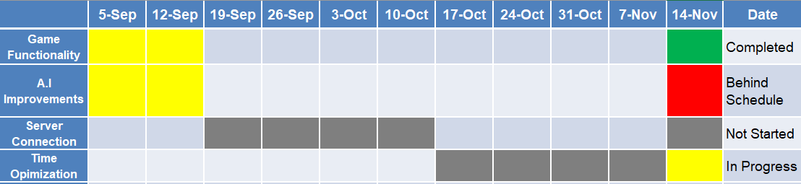
Project Timeline
Notes:
Eric

Slide 11
Parts Ordering Status
Parts Ordered | Parts Received
Samsung Galaxy 6 Smartphone | Received
Notes:
Michelle

Slide 12
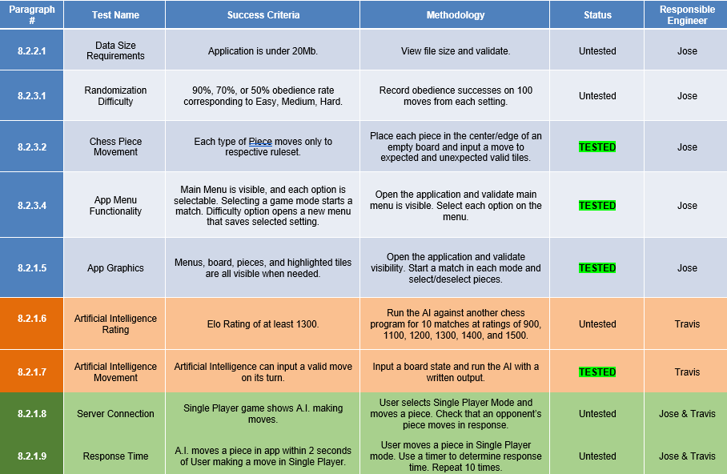
Execution & Plan
Notes:
Michelle

Slide 13
Questions?

